Slide 1



Turbocharge
Power BI
using
Azure Synapse Analytics

Slide 2





Session Overview
Dedicated SQL Pools
Serverless SQL Pools

Slide 3

Dedicated SQL Pools
Materialized Views
We can pre-aggregate data ready for querying
Data is physically stored ready for querying
We still need to be mindful of data distribution
Data is imported into the database
Dedicated SQL Pool
Automatically Updated
Load Data
Web Activity Table
Materialized Views can pre-process complex data to be available for querying
Materialized View
Date Dimension
Table

Slide 4
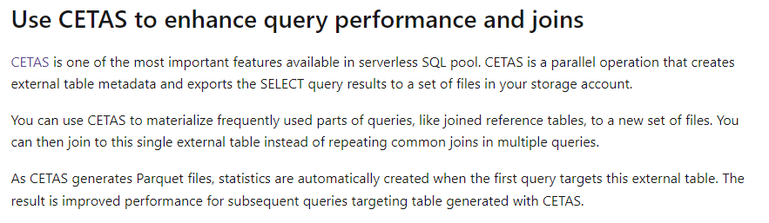
Serverless SQL Pools
Create External Table As Select
We can pre-aggregate data using SQL
Data is saved to a new folder in the Data Lake
A View selects the data from the most recent folder
Connect to data in Data Lake
Data Lake
Serverless SQL
Load Data
\source data\
CETAS
We can use CETAS to create a pre-processed dataset that can be consumed by SQL clients (Power BI etc)
\aggregates\
\20211801053000\
\20211901053000\

Slide 5




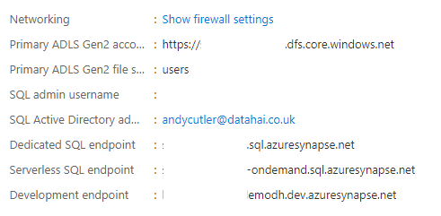

Connection
SQL Server Management Studio
Endpoint
Azure Data Studio
Serverless and Dedicated SQL Pools have separate endpoints that other data services and clients can connect to and issue SQL statements
SQL
Endpoint
Azure Analysis Services
Power BI (Datasets & Dataflows)

Slide 6
Demo

Slide 7
Thank you

